Slide 1


SEIS 632-01 Data Analytics and Visualization Project
College dataset
Avinash vermA
Image link: shorturl.at/fjkJY

Slide 2
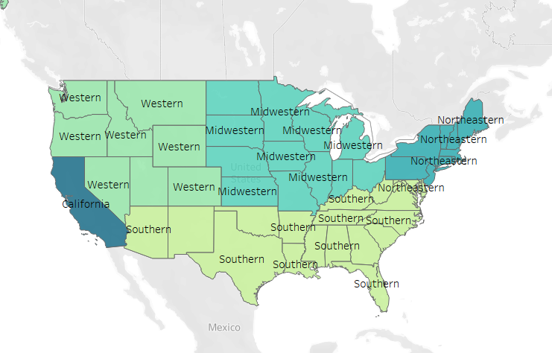
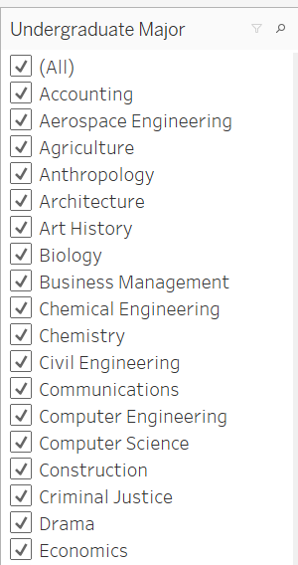
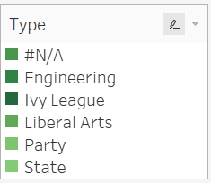

SEIS 632-01 Data Analytics and Visualization Project
College dataset
Region
The dataset consists of following attributes:
Starting median salary
Mid career median salary(salary after 10 years)
Mid career 10th, 25th, 75th and 90th percentile salary
The salaries are based on three parameters : College type, Region and Major.
As this is a survey dataset, we observed some missing values and outliers in our dataset, like:
Some colleges did not had the college type.
Salaries for some percentiles were missing.
We also observed few outliers which we kept untouched as suggested by our prof.
Also, there were few duplicate values which we removed successfully .
The question which we thought of addressing here with our project is how to select the best college so that one can make more earnings in the long run.
Major
College Type
Avinash vermA
Image link: shorturl.at/fjkJY

